Slide 1
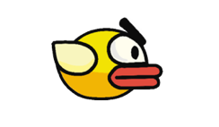

Flappy Bird
Industrial Training & Presentation (ECS 791)
Project Guide:
Ms. Rohaila Naaz
(Assistant Professor)
Presented by:
(TCA1809023) Aman Madhok
(TCA1809072) Kshma Sethi

Slide 2
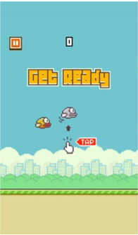
Overview
In this game, the main objective of the player is to gain the maximum points by defending the bird from hurdles.

Slide 3

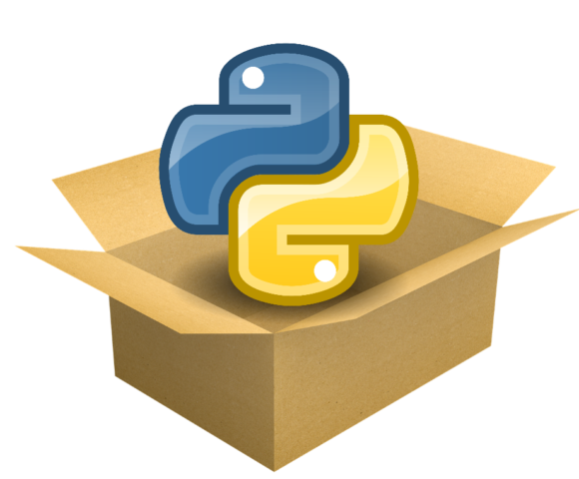
Imported the following Modules:
Random
Sys
Pygame

Slide 4

Pygame
Pygame is a cross-platform set of Python modules which is used to create video games.
It consists of computer graphics and sound libraries designed to be used with the Python programming language.

Slide 5
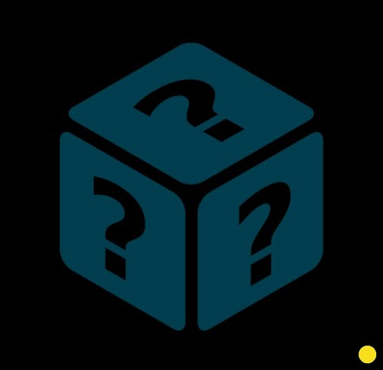
Random
Python Random module is an in-built module
of Python which is used to generate random
numbers. These are pseudo-random numbers
means these are not truly random.

Slide 6
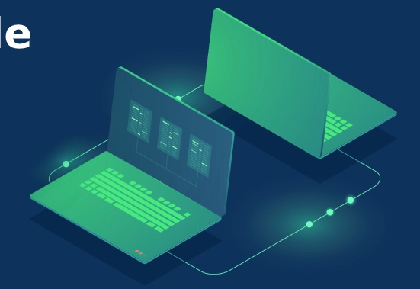
Sys
It provides various functions and variables that are used to manipulate different parts of the Python runtime environment.

Slide 7

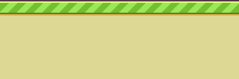
How To Play?
Press Spacebar to go up.
Press Spacebar to not go down.
Every time you pass a pipe, your score increases.
You hit the ground or the pipes, you lose.

Slide 8
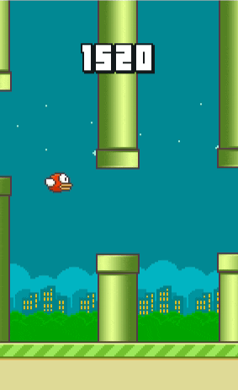

Gameplay

Slide 9
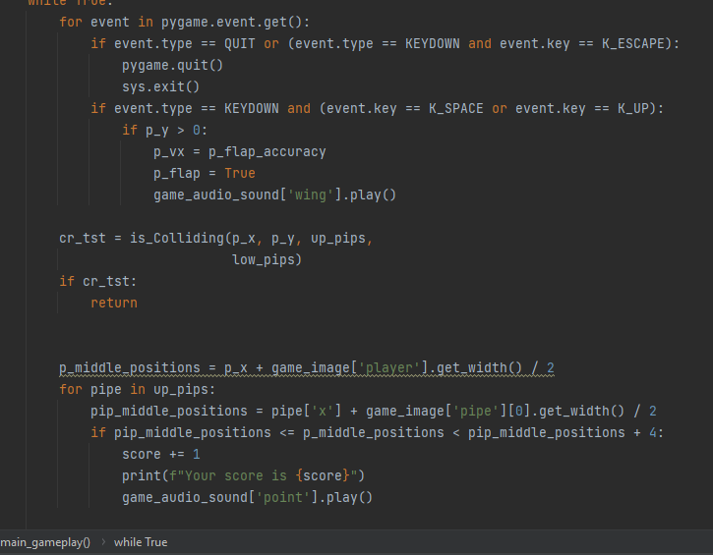
Code Snippet

Slide 10
ADVANTAGES
Overall customer satisfaction
Enhances concentration

Slide 11

Future Scope of the Project
The most important bit for Video game in the future is to be more interactive and converting it into multi-player game.

Slide 12

THANK YOU!

